Slide 1
Pathways to Sustainable Development: Towards the Dominican SDGs
Glenn Denning
Director-SDSN (New York)
Professor of Professional Practice
School of International and Public Affairs (SIPA)
Columbia University

Slide 2
Sustainable Development Solutions Network (SDSN)
Established by the UN Secretary General in August 2012
Provide independent scientific and technical support on SD
Engage universities, research institutions and think tanks
Joint learning and cooperation on problem solving
Synthesis of best practice and advocacy on solutions
Governed by a high-level international Leadership Council
Secretariat in New York, Paris and New Delhi
Regional and National SDSNs
Solutions Initiatives (e.g. Deep Decarbonization Pathways)
SDSNedu (MOOCs and more)

Slide 3
Pathways to Sustainable Development
The pathways to sustainable development must satisfy three principles: economic growth, social fairness and environmental sustainability.
A global, results-oriented framework is needed.
Goals, targets and indicators must be agreed and progress monitored.
Universality: From MDGs (8) to SDGs (17)

Slide 4
Pathways to Sustainable Development
Rio+20: The Future We Want (June, 2012)
UN General Assembly is currently negotiating the SDGs
Complete the work of the MDGs and
Tackle new challenges including: sustainable agriculture, energy, infrastructure, industrialization, inequality, sustainable production and consumption, oceans, climate change, peaceful and inclusive societies, effective and accountable institutions.
Current status: SDGs (17) and targets (169) will likely be adopted on September 25, 2015; indicators will take longer (2016)
Some consensus on universality; holistic approach; local prioritization; little thought on implementation

Slide 5
Financing for Development
Third International Conference on Financing for Development, Addis Ababa, Ethiopia (June 12-16, 2015)
SDSN recommends:
Align principles of FfD with the SDG agenda and adopt clear timelines for implementation
Increase the quality and volume of public and private funding: Domestic Budget Revenues and International Development Financing, complemented by Commercial Private Financing
Commit to effective pooled financing mechanisms to support the SDGs including a new Global Fund for Education
Implement effective national and global rules for investment, finance, and trade that are consistent with SD
Current status: low ambition, short on specifics, deferred action

Slide 6
COP-21: Action on Climate Change
21st Conference of the Parties (COP21) of the United Nations Framework Convention on Climate Change (UNFCCC), Paris, France (December 2015)
SDSN recommends:
A clear commitment to the 2°C upper limit on global warming
A clear commitment by all governments to achieve net-zero GHG emissions by 2070
Each national government should agree to prepare and submit a legally non-binding National Deep Decarbonization Pathway (NDDP) to demonstrate how it intends to shift to a low-carbon energy system by 2050 and achieve near-zero net GHG emissions by 2070.
High-income donor countries should make clear how they plan to fulfill the pledge of at least $100 billion per year of “climate finance” by 2020.
The Lima – Paris Action Agenda should launch several Global Public-Private Partnerships on Low-Carbon Technologies.
Current status: Paris outcomes could be modest, insufficient precision and boldness

Slide 7
Implications for the Dominican Republic
Public awareness campaign around the SDGs
Consultation to align/mainstream the SDGs and DR’s development priorities and political agenda
Dominican SDGs
Establish a multi-stakeholder alliance to support SDG implementation and mobilize resources (SDSN-DR)
Flagship projects (“Solutions Initiatives”/DDPP)
Regional leadership role through innovation and partnership: SDSN-Caribbean
Mobilize Dominican youth (SDSN-Y)

Slide 8
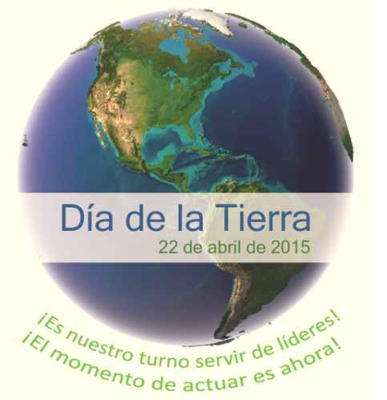
Sustainable Development Solutions Network (SDSN)
Learn more at unsdsn.org

